Slide 1
Hicure
Natural Power

Slide 2
Current European situation forces market changes
Crisis impacts growers and distribution channel
Plant quality & low residue
Pressure on profitability
Robustness & shelf life
Emphasis on sustainable solutions
Retailers demand crop sustainability
Growers look for products which are compatible in crop programs
Consumers look for “greener” crops
Source: ECPA, Italian research institute Nomisma, Humboldt Forum for Food & ag Agriculture

Slide 3
Our belief in a sustainable world
Why
We want to participate in a sustainable world
How
By combining our expertise and your needs to develop a new natural product
What
Biological stimulant
Improve quality and shelf life
Improve profitability
Fits in every crop program

Slide 4
Value of hicure
The new powerful biostimulant which is safe in every aspect. You can rely on to mitigate stress ; it will provide quality and shelf life to ensure the value chain requirements.
Product Positioning
Value
Natural
Powerful
Reliable
Safe to crops and nature
Improved vitality / shelf life
Bio certified*
Improved profitability
Increased roots vigor
Ease of use
Proven expertise
Crop program compatible
Extensive trial results
Benefits
*Note: Natural origin (acc. EU/354/2014)

Slide 5
Biostimulation new natural solution
CROP BIOSTIMULATION
e.g. Amino Acids
CROP PROTECTION
Fungicides
Herbicides
Insecticides
PGR
CROP NUTRITION
Fertilizers
Soil Amendments
Substrates
Plant biostimulant contains
Substances and/ or Micro-organisms
It functions when applied to plant or rhizosphere
It helps to stimulate natural processes
To benefit nutrient uptake and nutrient use efficiency
To Tolerance to abiotic stress
To improve crop quality
Source: EBIC, The European Biostimulants Industry consortium
Notes:
In Polen is er geen beleid op het gebied van biostimulanten vandaar dat hicure wordt geregistreerd als meststof. Claimen van plantversterkende werking wordt onderzocht wat we mogen claimen

Slide 6
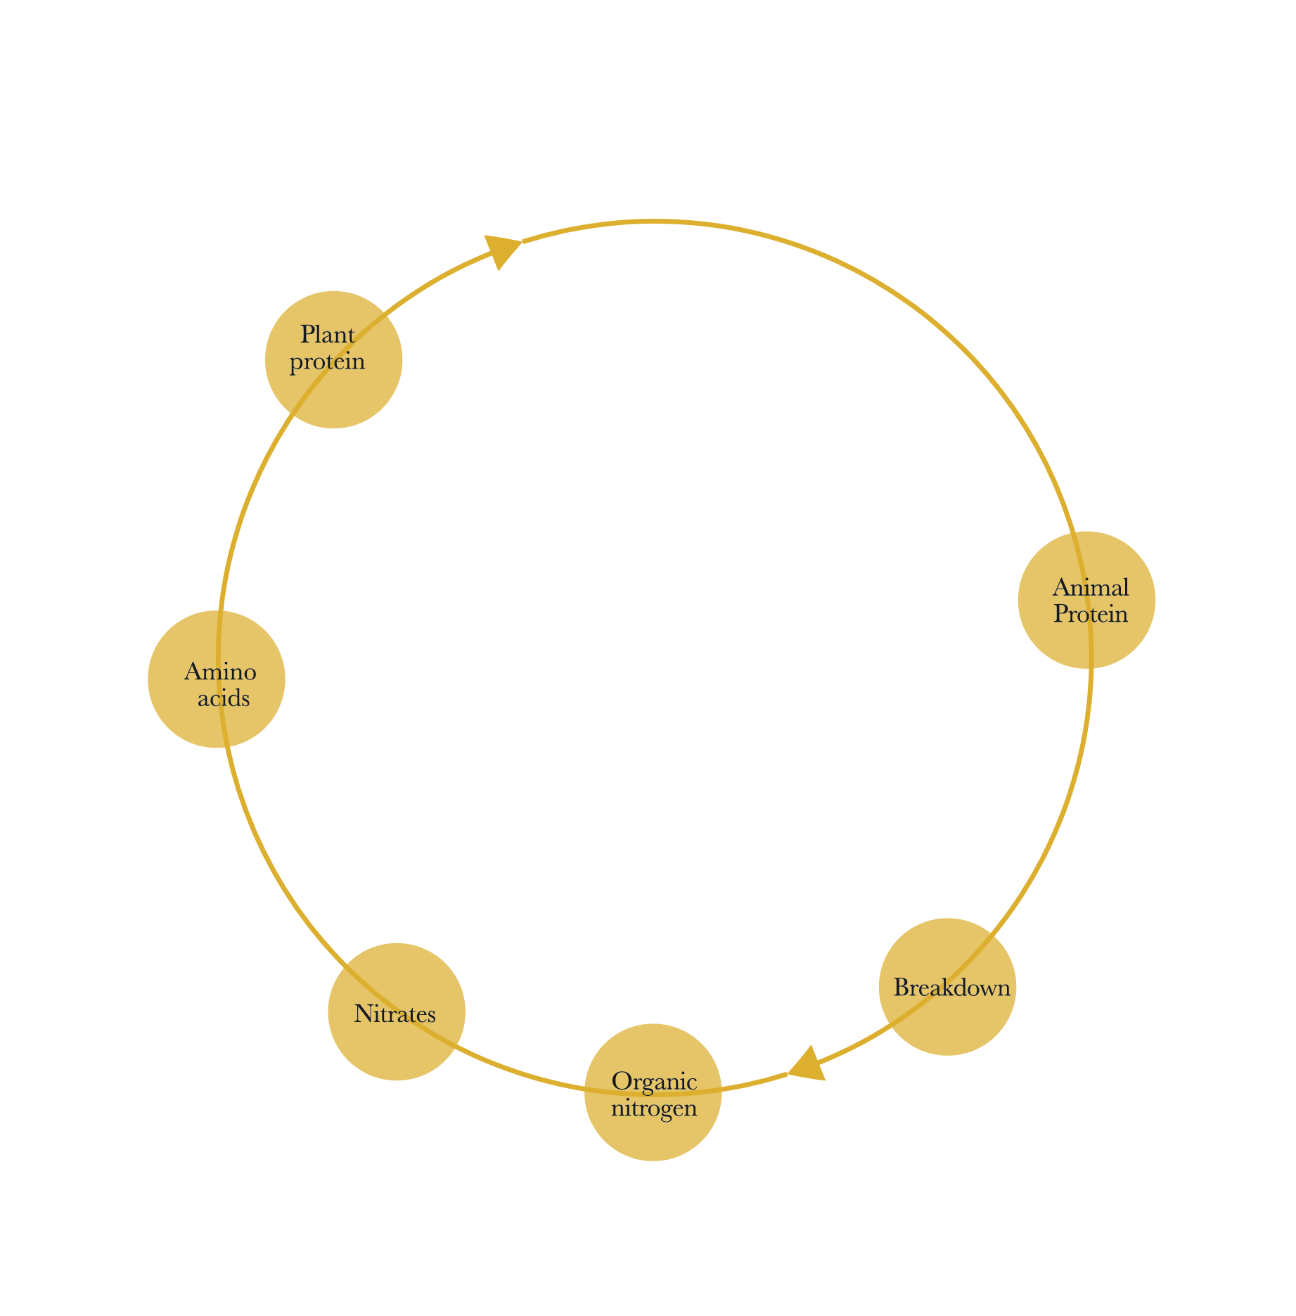
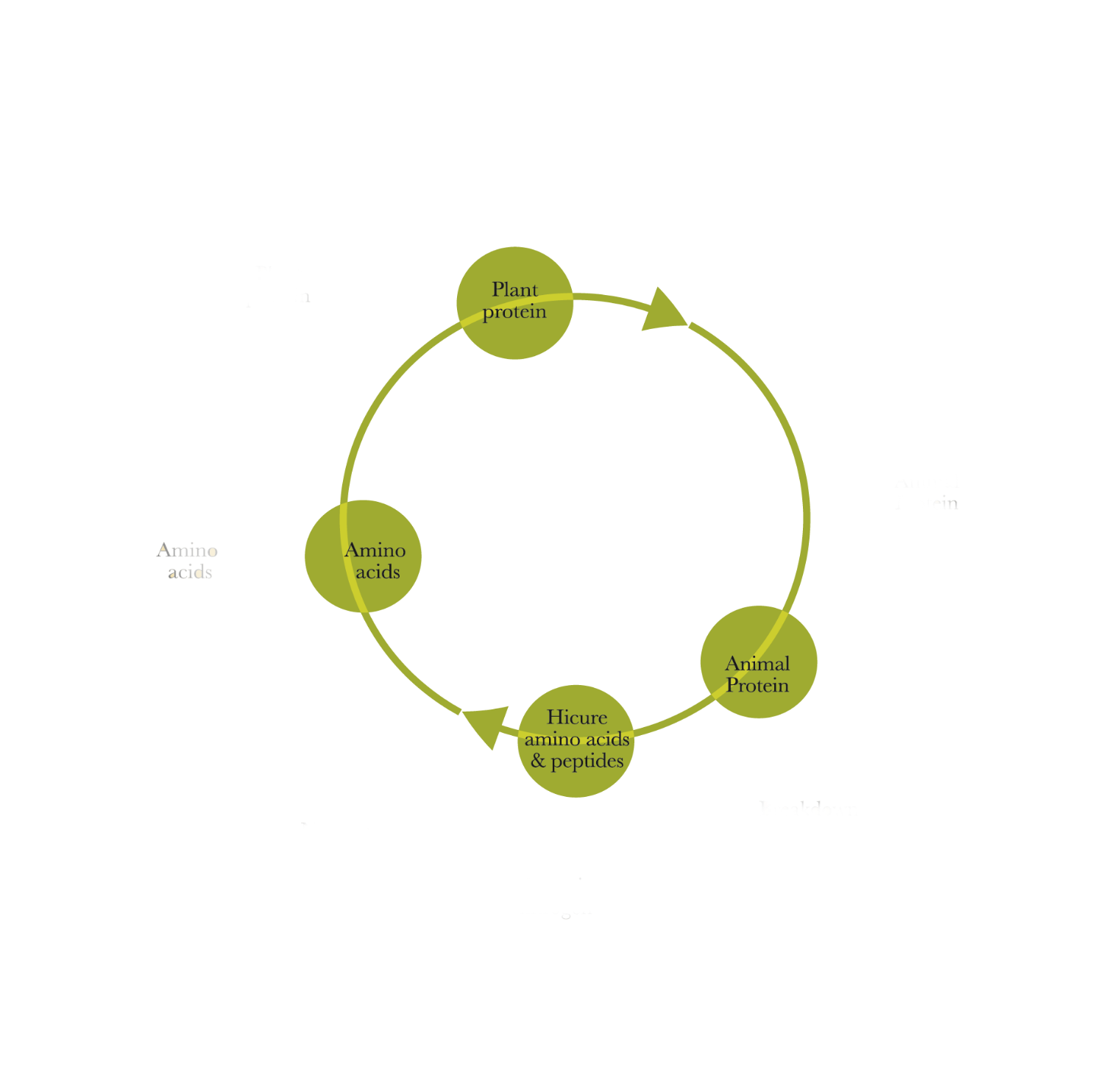
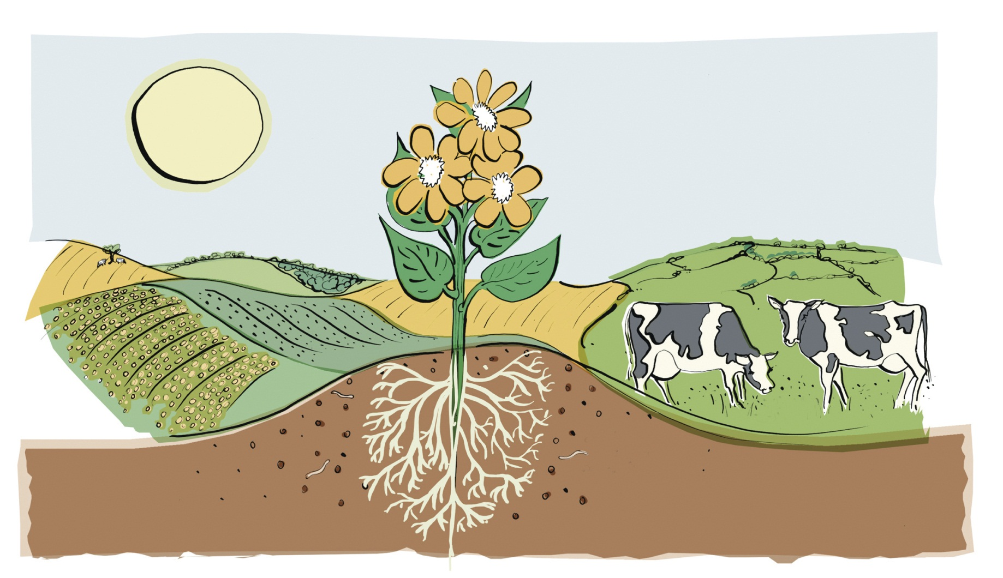
Biostimulation save plant energy
Hicure gives the plants the amino acids and peptides they need already formed, saving biological energy
Notes:
The creation of proteins by connecting specific amino acids is consuming energy which a plant also can use for e.g. photosynthesis. By providing 'ready to use' amino acids the plant can save energy which can result in better production
In periodes van stress breekt de plant z’n eigen aminozuren af.

Slide 7
Your Highest concentrated product
Composition: 62.5% w/w amino acids and peptides
Formulation: Transparent liquid (SL)
Packaging: 5 liter S-Pac bottle
Ashes
4%
Peptides
Water
34%
52%
Peptides
10%
Free Amino Acids

Slide 8
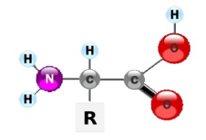
aminozuren zijn de bouwstenen voor proteÏnen
Aminozuur
Peptide keten
sub-unit
Proteine
Aminozuren:
Zijn de bouwstoffen voor alle eiwitten.
Zijn het startpunt voor de synthese van o.a. vitaminen, nucleotiden, chlorophyll, enzymen, proteïnen, etc..
Vervullen een belangrijke voedende functie tijdens o.a. zaadkieming, eiwitsynthese en de vorming van phytohormonen.

Slide 9
High content of Free amino acid and short chain peptides
%
%
Molecular weight (dalton)
Easy uptake by leaves and roots
Minimal use of energy for proteins synthetizing
Notes:
In NL presentatie uitleg eiwit opbouw (peptides)
Zoveel te korter de keten zoveel te korter bij de planteigen aminozuren

Slide 10
functies van aminozuren in planten
Fysiologische functie | Gerelateerd aminozuur
Blad en knopgroei | Glycine
Regulering huidmondjes | Proline
Vorming celwand | Proline, phenylalanine
Chelaatvorming nutrienten | Glycine
Waterhuishouding | Proline, serine
Anti verouderingseffect | Proline, arginine, methionine
Systemic acquired resistance (SAR) | Glycine, lysine, glutamic acid
Hicure stimuleert planten tijdens cruciale fysiologische fasen en onder suboptimale teeltomstandigheden

Slide 11
Your advantages / benefits with hicure
Reliable product
Proven stress reduction
Improve vitality & shelf life
Better roots development
Crop losses reduction
Increase yield
Flexible product
Easy uptake by the crops
Easy to apply
Easy to tank mix with other products
Low dose rate application
Natural product
Natural origin*
Safe to beneficials
IPM compatible
Ornamental product
Dedicated to ornamental growers
Orenamental product expertise
Highest concentration of Amino acid
*Note: Natural origin (acc. EU/354/2014)

Slide 12
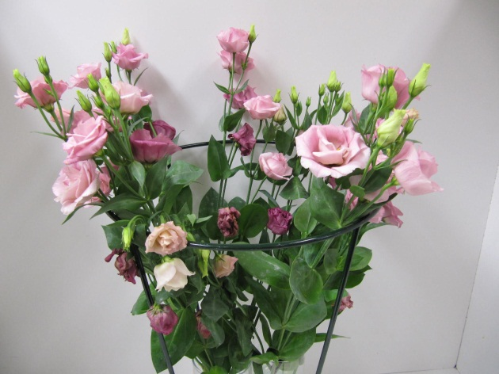
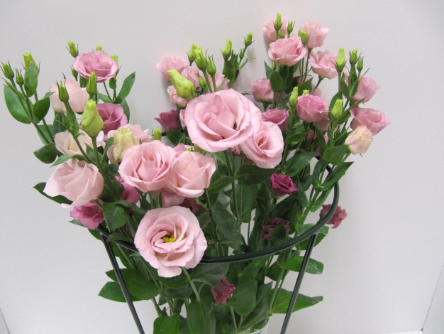
improvement quality & shelf life of your cutflowers
%
Lisianthus*: 9 days at consumer phase
Hicure can improve the quality and shelf life of cut flowers
Increased shelf life of 1,5 days
12-18% less wilted leaves
Untreated
Source trials: Flora Holland
*Lisianthus weekly treatment at 1.25 l/ha

Slide 13
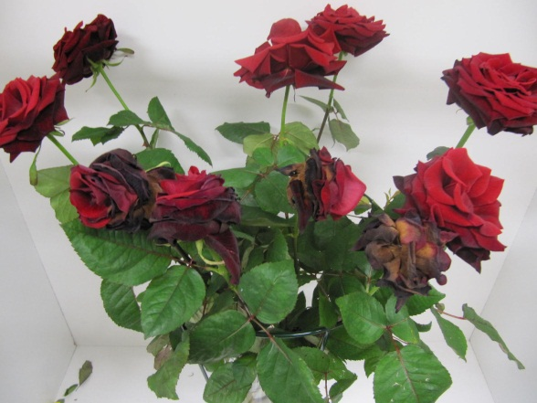
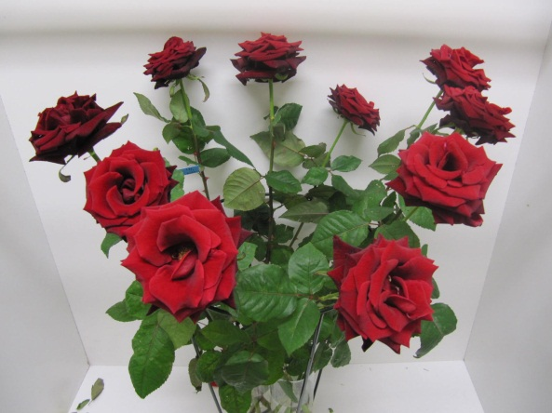
Hicure improves Robustness & shelf life of your cutflowers
Roses*: 7 days at consumer phase
Stronger against shelf life diseases during low light season
Improved shelf life up to 4 days
Hicure makes crops stronger against Botrytis:
Hicure extends shelf life of cutflowers
Untreated
%
Source trials: Flora Holland
*Rose on weekly drip irrigation with 1.25 l/ha
Notes:
November gestart met druppelen

Slide 14
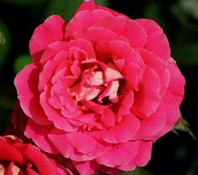
Use & recommendations In cutflowers
Crop | Cultivation method | Application type | Dose (product) per treatment | Minimum water volume | Recommended interval (days)
Cutflowers | Greenhouse | Foliar | 0,125% (125 ml / 100 L water) | 1000 L/ha | 5-7
 |  |  | 0,25 % (250 ml / 100 L water) | 1000 L/ha | 10-14
 |  | Soil/ irrigation | 2,5 L/ha | NA | 10-14
 | Field | Foliar | 1,25 L/ha | 400 L/ha | 5-7
 |  |  | 2,5 L/ha | 400 L/ha | 10-14
 |  | Soil | 2.5 L/ha | NA | 10-14
Recommendation in Greenhouse/Field
Planting
Crop development
Flower induction
Flowering
Harvest
Hicure usage
weekly
Every 2 weeks
weekly
Every 2 weeks
Root development
Drench/Foliar
Stress mitigation
Foliar
Crop and shelf life
Foliar
Source trials: Syngenta
Notes:
Advies slide eventueel weglaten

Slide 15
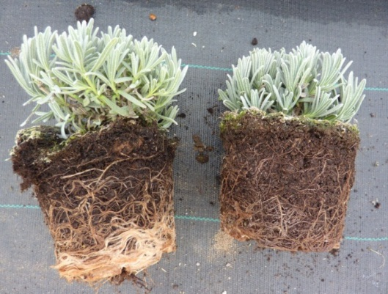
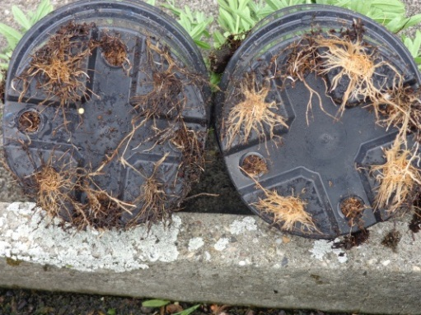
improves consumer garden performance in Pot & Bedding
Lavendula*: Trials at DLV (NL)
Higher vitality of outdoor plants
Increased number of flowers in the garden
Hicure stimulate roots development
Better plants quality
Untreated
Lavendula: Trials at growers (Ger)
Untreated
Source trials: DLV & growers
*Transport and store simulation trial Lavendula ‘Blue Scent’®
Notes:
Op het veld was niets te zien
Proef een tuinsimulatie

Slide 16
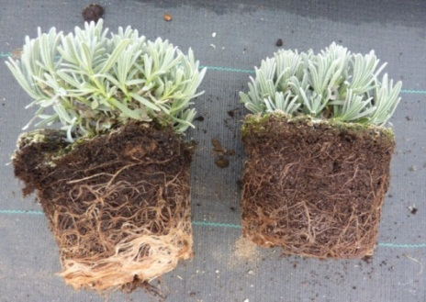
Hicure in vaste planten
Hicure stimuleert de wortelontwikkeling en verbetert daardoor de kwaliteit van de plant
Proef DLV Boskoop 2014
Lavendula ‘Blue Scent’
Plantdatum: 2 mei (buiten)
Transportsimulatie: 15 juli
Winkelsimulatie: 17 juli
Tuinperformance buiten: 25 juli
Hicure Onbehandeld
Onbehandeld Hicure
Notes:
Ivm de gegevens

Slide 17
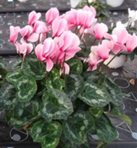
Hicure make your plants stronger
Cyclamen*: 4 weeks at consumer phase
Hicure enhances the vitality of the plants and makes them stronger against disease
Delay in Botrytis development in the plants & on the flowers
Untreated
Source trials: Botany NL
*DALA: days after last application
Cyclamen: artificial infestation with Botrytis spores

Slide 18
Meeldauwbestrijding roos - Red Naomi -
Hicure verbetert de weerbaarheid in roos.
In combinatie met chemie wordt meeldauw beter beheersbaar.
- Red Naomi (praktijk)
- 4 toepassingen
- 7 dgn interval
- Juni 2014

Slide 19
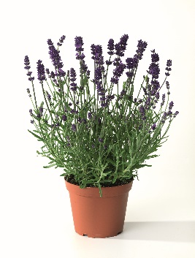
Use and recommendations in Pot & bedding plants
Crop | Cultivation method | Treatment type | Dose (product) per treatment | Minimum water volume | Recommended interval (days)
Pot plants | Greenhouse | Foliar | 0,125% (125 ml / 100 L water) | 1000 L/ha | 5-7
 |  |  | 0,25 % (250 ml / 100 L water) | 1000 L/ha | 10-14
 |  | Drench | 0,25 % (250 ml / 100 L water) | Drench with 10 % of pot volume | 10-14
Recommendation in Greenhouse
Planting
Crop development (Pinching)
Flower induction
Flowering
Delivery
Hicure usage
weekly
Every 2 weeks
weekly
Every 2 weeks
weekly
Every 2 weeks
Roots development
Drench
Stress mitigation
Foliar
Crop and shelf life
Foliar
Source trials: Syngenta

Slide 20
Houdbaarheid Helleborus orientalis (snij)
PT project Helleborus als houdbare snijbloem
Uitgevoerd door Nieves Garcia, Wageningen UR glastuinbouw
Oogstdatum 12 februari, op de vaas 13 februari
Soort: Queens white
Geen voorbehandelingsmiddel
Behandeling 3x wekelijks met 125 ml Hicure per 100 ltr water, 1000 ltr per ha

Slide 21
Further information
Karin R
Product availability When
Contact
Information products (Tech brochure, Leaflet, website)

Slide 22
Q&A
Is it mixable with growth regulators like Bonzi, Carax, Dazide Enhance, Regalis ?
Is it mixable with fungicides like Switch / Ortiva?
HICURE can be tankmixed with a large number of products amongst others fertilizers and most crop protection products, test are done an no negative effects are observed. A test application on a small area is recommended if there is no experience with a certain mixture to avoid crop damage. Precautionary mixtures with more than two products are discouraged. Do not use Hicure in combination with sulphur, mineral oils or cupper containing products as this can cause serious crop damage.
Is there a Phytotox risk in young plants?
Hicure is tested in young plant production of several crops and nog negative effects are observerd. A test application on a small area is recommended if there is no experience with a crop

Slide 23
Q&A
What is the amount of water to use by spraying / drenching of the different crops?
For foliar applications we recommend 1.000 – 1.500 liter of water per ha. Drench rates are depending on potsize and number of plants per ha. Recommandation is to make a solution of 0.25% and drench per pot with 10% of the potvolume
What is the optimal temperature to apply the product ?
Hicure is not sensitive for temperature. At lower temperatures the plants will be less active which might result in a reduced uptake
What is the effect on root development when dripping the product ?
In tests it is proven that roots do develop better with drenches. In the first weeks the differences are small but root development will contnue longer with drenches of Hicure
What is the optimal temperature to store Hicure?
HICURE doesn’t contain any preservatives and is stable for more years provided stored in closed packaging. It is recommended to store the product in a well-ventilated place at a temperature between 0 and 25°C. Do not expose the packaging to direct sunlight.

Slide 24
Amino acids play a key role in your crop development
Growing conditions
Normal
Plants synthesize their own amino acids through thousands of chemical reactions and a significant use of energy
These activities require an extraordinary use of energy by plants and consequently reduces quality of the plants and market value (€)
Stress/ Sub-optimal
Plants decrease or stop the synthesis of amino acids and have to hydrolyze or break down structural proteins to obtain the required amount or types of amino acids

Slide 25
use and recommandation
Crop | Cultivation method | Application type | Dose (product) per treatment | Minimum water volume | Recommended interval (days)
Pot plants | Greenhouse | Foliar | 0,125% (125 ml / 100 L water) | 1000 L/ha | 5-7
 |  |  | 0,25 % (250 ml / 100 L water) | 1000 L/ha | 10-14
 |  | Drench | 0,25 % (250 ml / 100 L water) | Drench with 10% of pot volume | 10-14
Cutflowers | Greenhouse | Foliar | 0,125% (125 ml / 100 L water) | 1000 L/ha | 5-7
 |  |  | 0,25 % (250 ml / 100 L water) | 1000 L/ha | 10-14
 |  | Soil/ irrigation | 2,5 L/ha | NA | 10-14
 | Field | Foliar | 1,25 L/ha | 400 L/ha | 5-7
 |  |  | 2,5 L/ha | 400 L/ha | 10-14
 |  | Soil | 2.5 L/ha | NA | 10-14
Tree nursery and perennials | Greenhouse | Foliar | 0,125% (125 ml / 100 L water) | 1000 L/ha | 5-7
 |  |  | 0,25 % (250 ml / 100 L water) | 1000 L/ha | 10-14
 |  | Drench | 0,25 % (250 ml / 100 L water) | Drench with 10 % of the pot volume | 10-14

Slide 26
Your Highest concentrated product
Composition: 62.5% w/w amino acids and peptides
Formulation: Transparent liquid (SL)
Packaging: 5 liter S-Pac bottle
Peptides
Free AA
4%
1%
Amino acids & peptides
Water
Ashes
Nitrogen
Organic Carbon
100%

